Slide 1
Automation: PoC VxLan Deployment

Slide 2

DellEMC Networking Ansible Support
RedHat Ansible Partner since inception
Networking, First class citizen from Ansible 2.1
Part of Ansible Advisory Board
Ansible is the primary choice of automation for Networking

Slide 3

DellEMC Networking Ansible Support
OS10
SONiC
Ansible
OS9
OS6

Slide 4
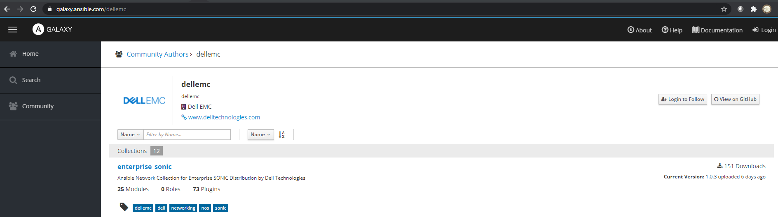
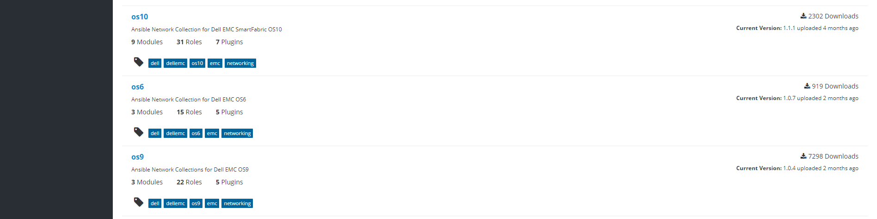
Ansible 2.10 Collection Support

Slide 5
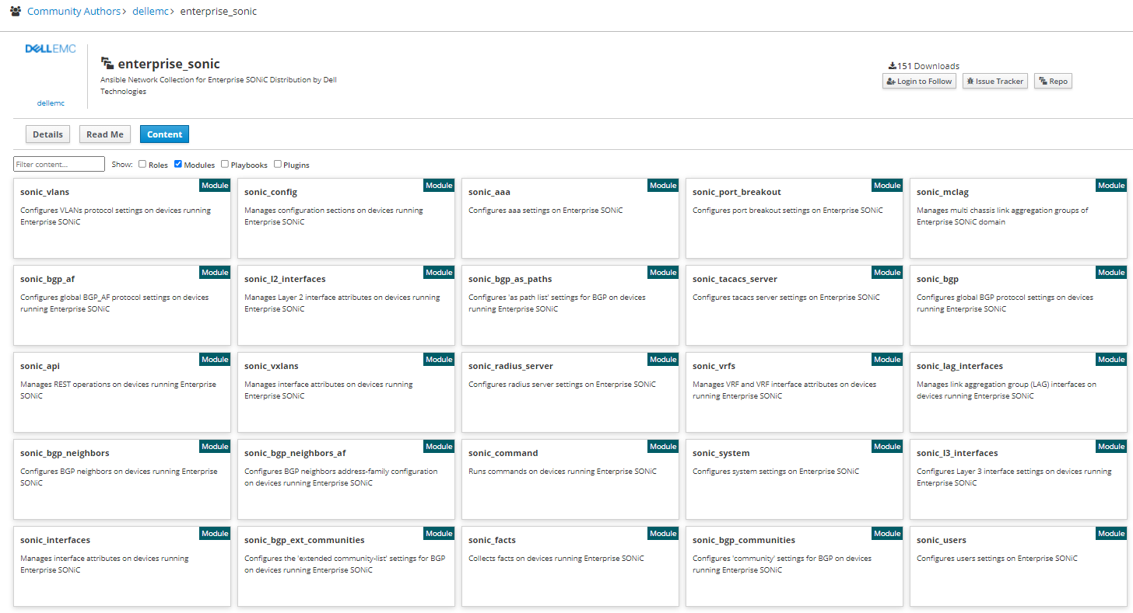
Ansible Core Modules

Slide 6
Ansible: SONiC VxLan PoC Demo
/home/linuxadmin/pocAnsibleDemo
host_vars
group_vars
inventory.yaml

Slide 7
host_vars
spine1.yaml
spine2.yaml
leaf1.yaml
leaf2.yaml
leaf3.yaml
leaf4.yaml
group_vars
all.yaml
spine.yaml
leaf.yaml
Playbooks
01_spine_underlay.yaml
02_leaf_underlay.yaml
03_leaf_mclag.yaml
04_spine_overlay.yaml
05_leaf_overlay.yaml
06_rack1_vxlan.yaml
07_rack2_vxlan.yaml
sonic_facts.yaml
sonic_hostname.yaml
inventory.yaml

Slide 8
Network Topology

Slide 9
Reference links
https://galaxy.ansible.com/dellemc
https://galaxy.ansible.com/dellemc/enterprise_sonic
https://ansible-dellos-docs.readthedocs.io/en/latest/roles.html
https://access.redhat.com/articles/3642632
https://www.ansible.com/integrations/networks/dell
https://gitlab.force10networks.com/kpatil/vaquita.git

Slide 10
Openstack

Slide 11
Network Topology

Slide 12





Logical Network
AS 65100
Spine
AS 65101
Internet
BGP EVPN
Logical VTEP
AS 65001
AS 65002
AS 65003
Border Switch
Compute-1
Controller
Compute-2
Compute-3

